Slide 2
Overview of Tutorial
Chapters 7 of Study Guide
Sequences and Series, and Proof by Induction
Sequences
Induction (Proof by Induction)
Series and Sigma Notation
Rules of arithmetic for sums
Subject Matter for Tutorial
Selected end of chapter revision questions
Selected past paper questions
Also
Questions and Queries

Slide 3
Chapter 7: Sequences and Series
Sequences
Recurrence Relations
Induction
Proof by Induction : particularly important for computer scientists
Series and “Sigma Notation”

Slide 4
Chapter 7: Sequences and Series
Arithmetic Progression
For example (with constant term d=2)
U_{n+1} = U_{n} + 2
Arithmetic progressions should have an initial value term. Otherwise they are not practical.
Geometric Progression
For example (with ratio term r=3)
U_{n+1} = 3U_{n}

Slide 5
Chapter 7: Sequences and Series
Other sequences
Respective values based on previous values
Famous example: Fibonacci Sequence
0, 1, 1, 2, 3, 5, 8, 13, 21,…….
Recurrence Relations
current value based on previous value
must have some initial value to allow for computing subsequent values
Fibonacci Sequence is a Recurrence Relation - Each value is sum of the two previous values, with first two values equal to 1.

Slide 6
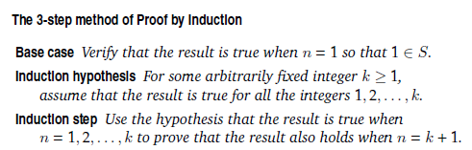
Proof By Induction
Proof by Induction
Used for proving results “for all positive integers n”

Slide 7
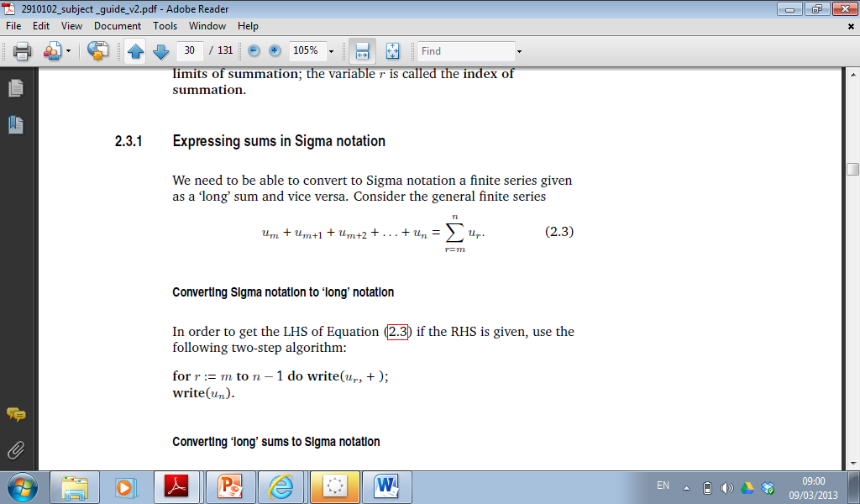
Series and Sigma Notation

Slide 8
Series and Sigma Notation
Notation is vitally important
Lower bound m
Upper bound n
Index symbol r
r is any value between m and n.
It does not need to be specified.
Pay attention to Example 2.7 – Sigma notation is not uniquely determined.
Sometime lower bound is zero. Sometimes it could be 1.

Slide 9

Sigma Notation
$$\frac{n\left(n+1\right)(2n+1)}{6}$$
Write the following sums in the Σ notation and evaluate them
1² + 2² + 3² + …+ 40² = ?
2 + 5 + 10 + … + 1601 = ?
2 + 8 + 18 +… + 3200 = ?

Slide 10
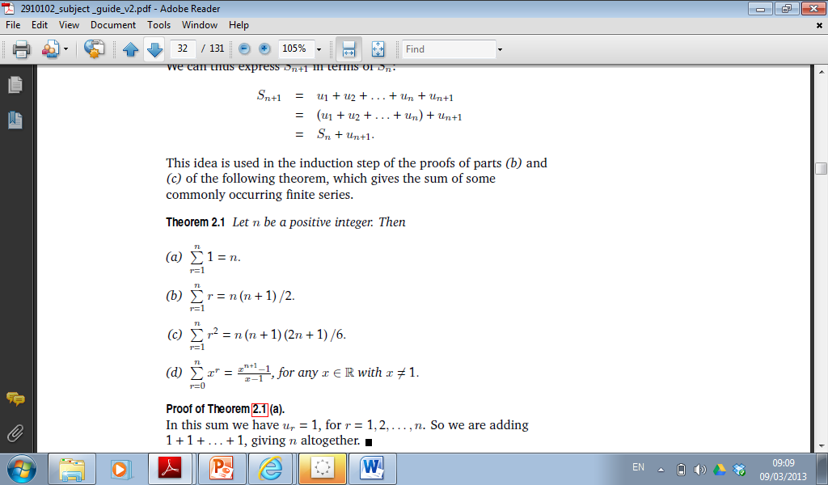
Standard Series

Slide 11
BLANK

Slide 12
Rules for Arithmetic
1) Expressing a sum as the difference of two sums
2) Taking out common factors
3) Splitting a sum into two or more components

Slide 13
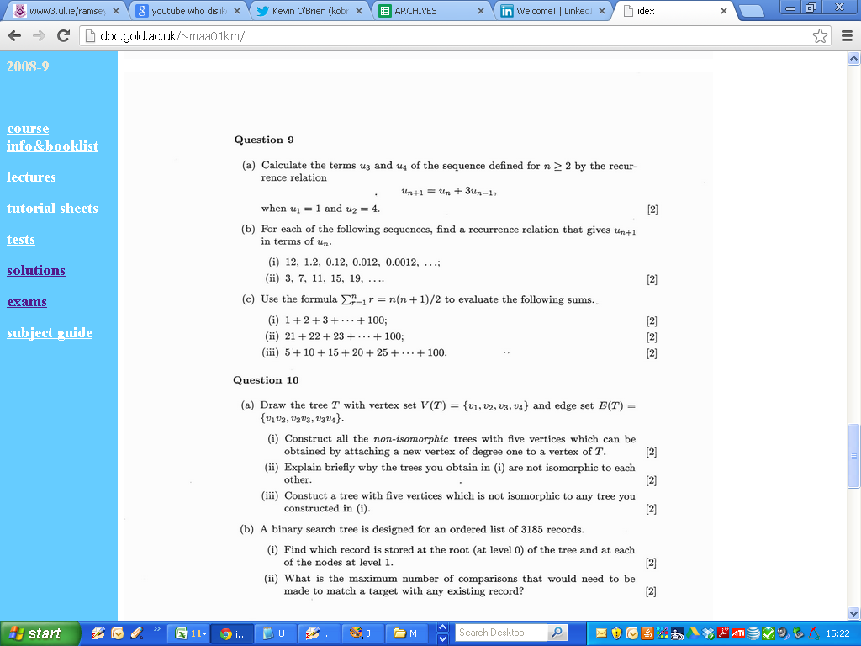
2001

Slide 14
2001

Slide 15
2001

Slide 16
BLANK

Slide 17
2001

Slide 18
2001

Slide 19
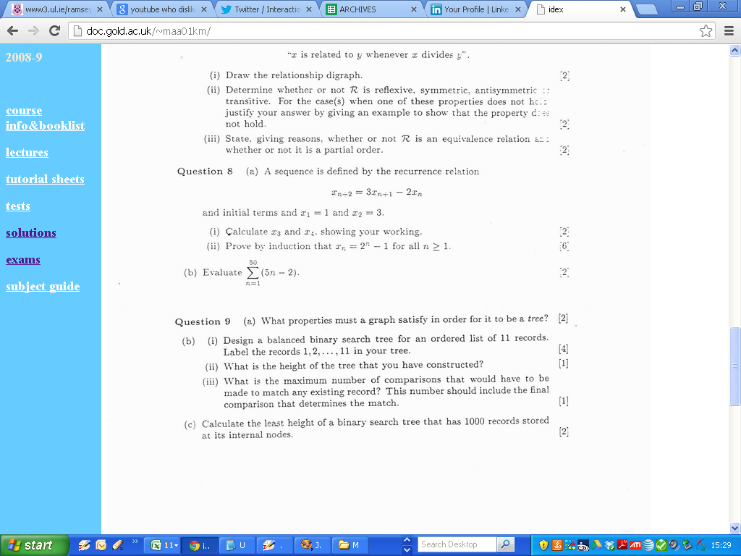
2002

Slide 20
BLANK

Slide 21
2002

Slide 22
2002

Slide 23
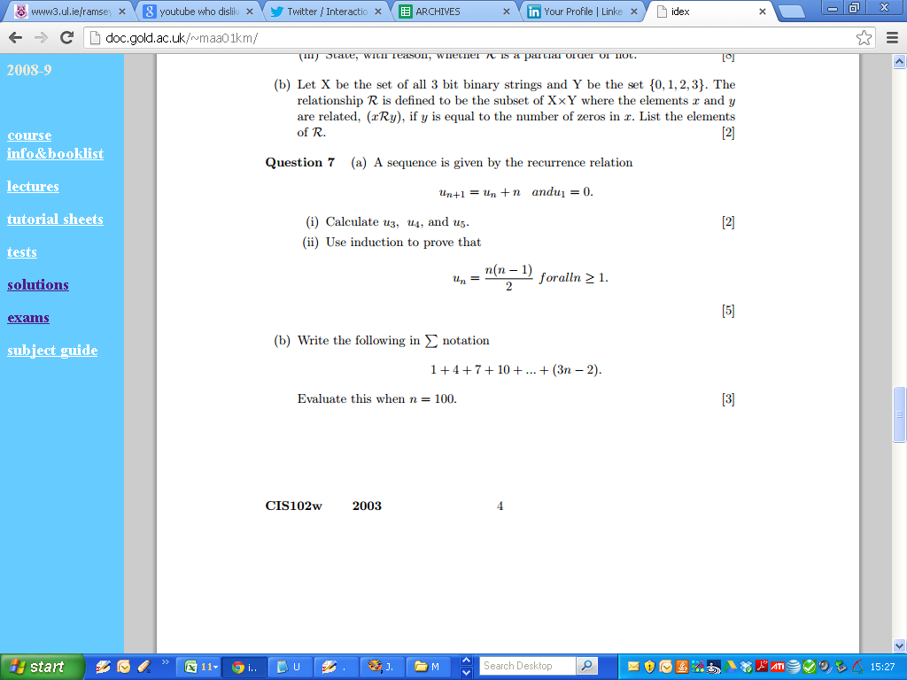
2003

Slide 24
2003

Slide 25
BLANK

Slide 26
2003

Slide 27
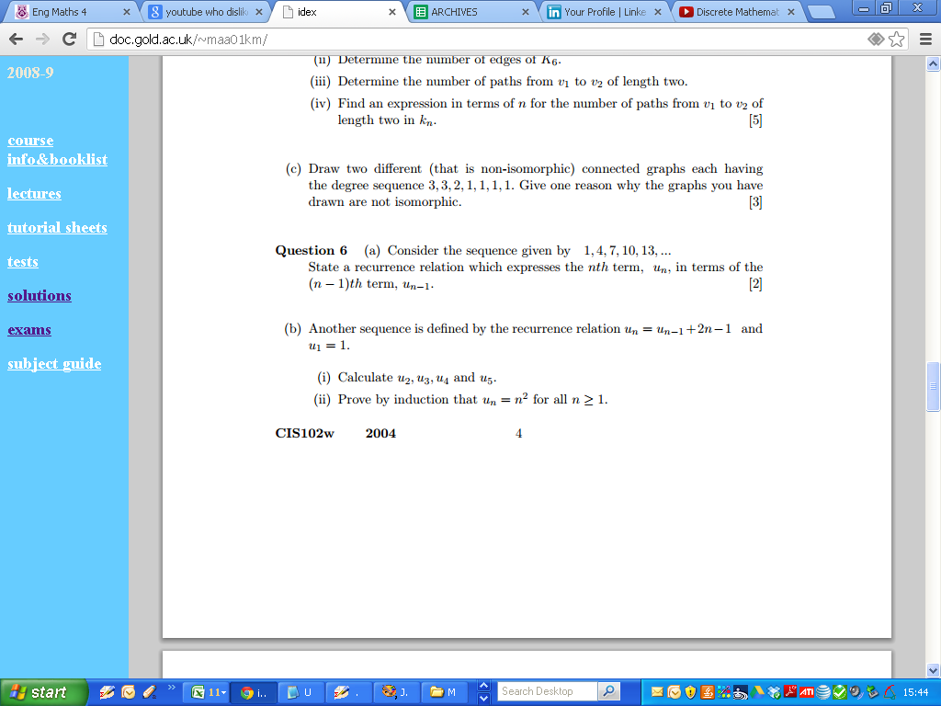
2004

Slide 28
2004

Slide 29
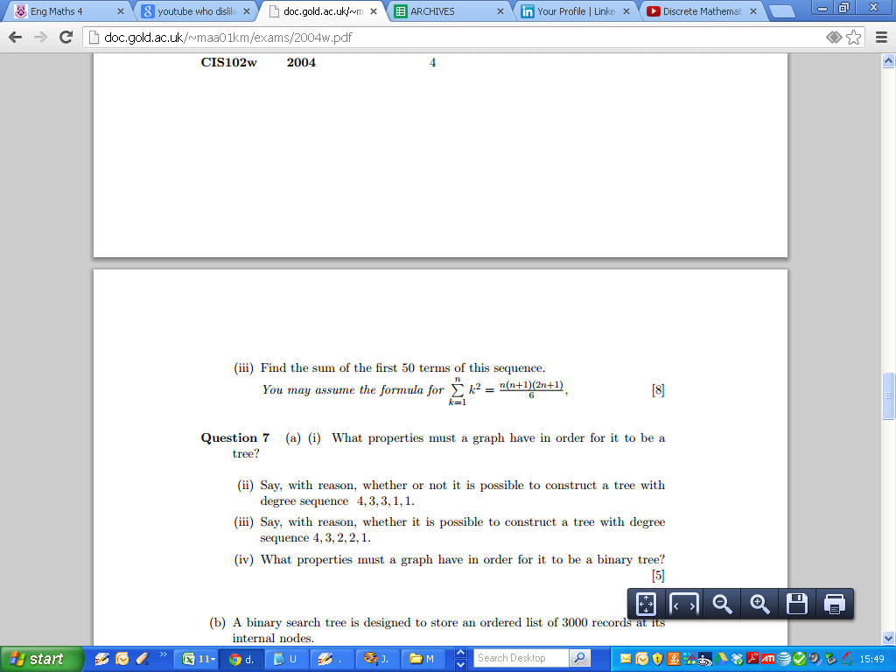
2004

Slide 30
BLANK

Slide 31
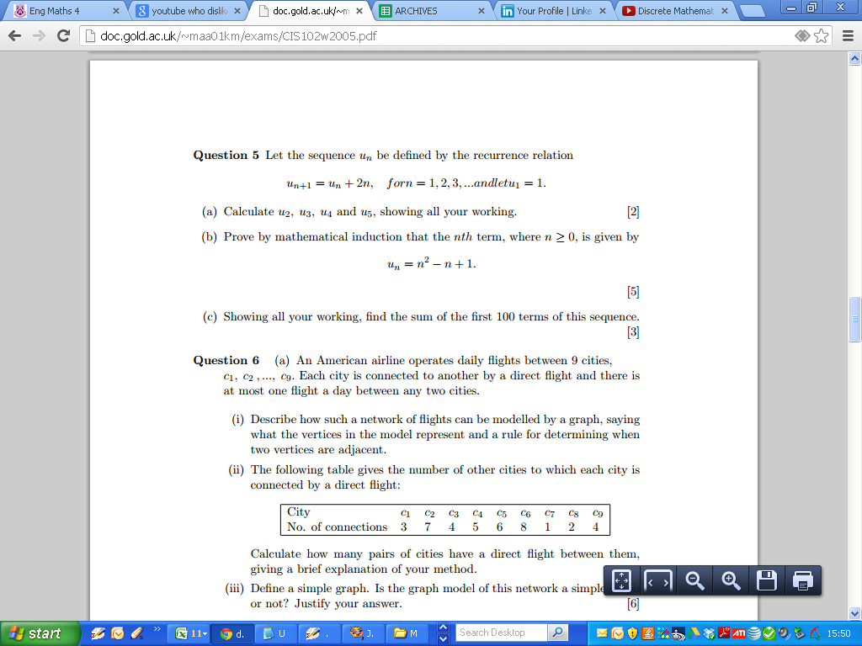
2005

Slide 32
2005

Slide 33
2005

Slide 34
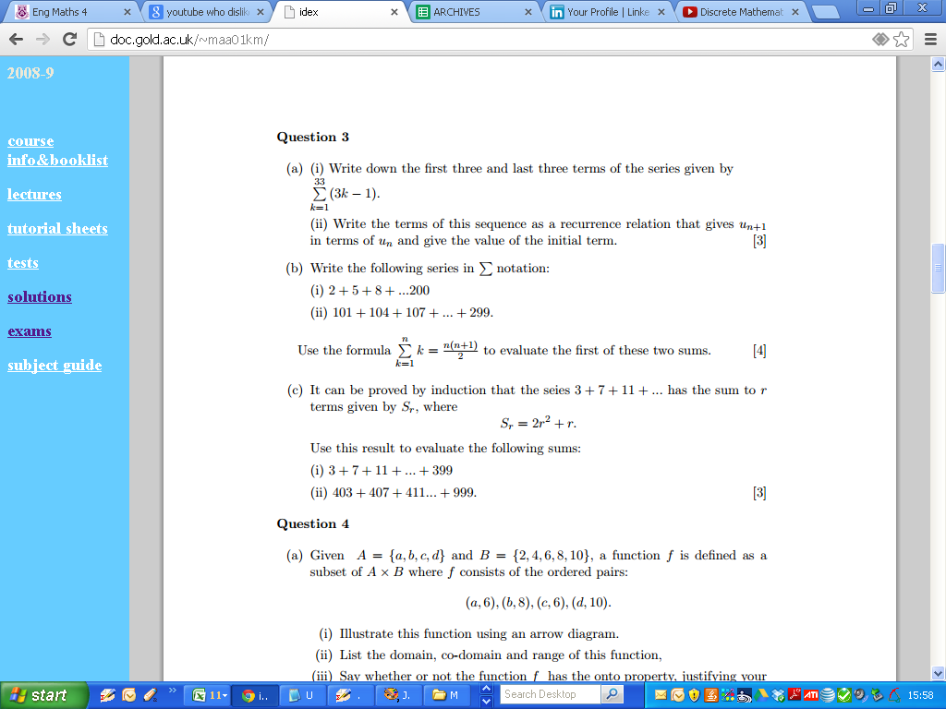
2006

Slide 35
BLANK

Slide 36
2006

Slide 37
2006

Slide 38
BLANK

Slide 39
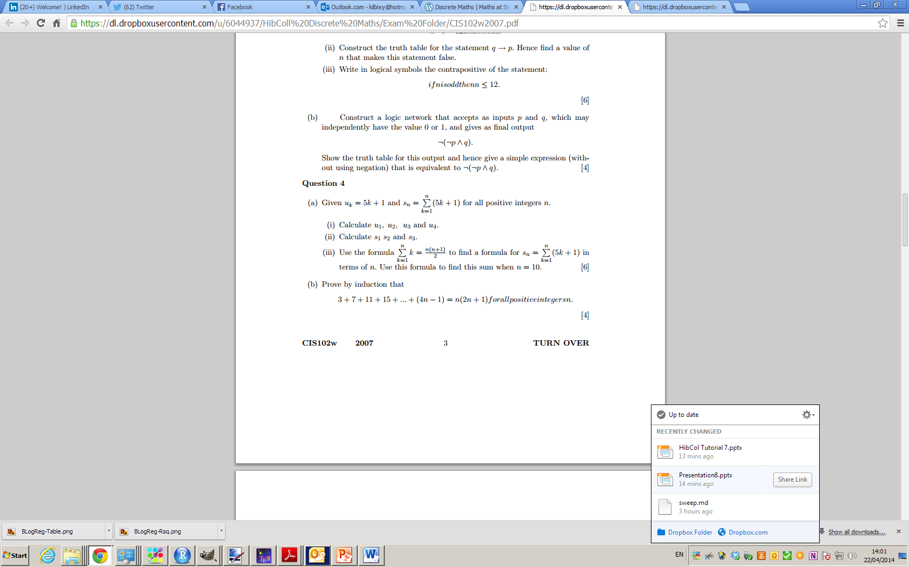
2007

Slide 40
2007

Slide 41
BLANK

Slide 42
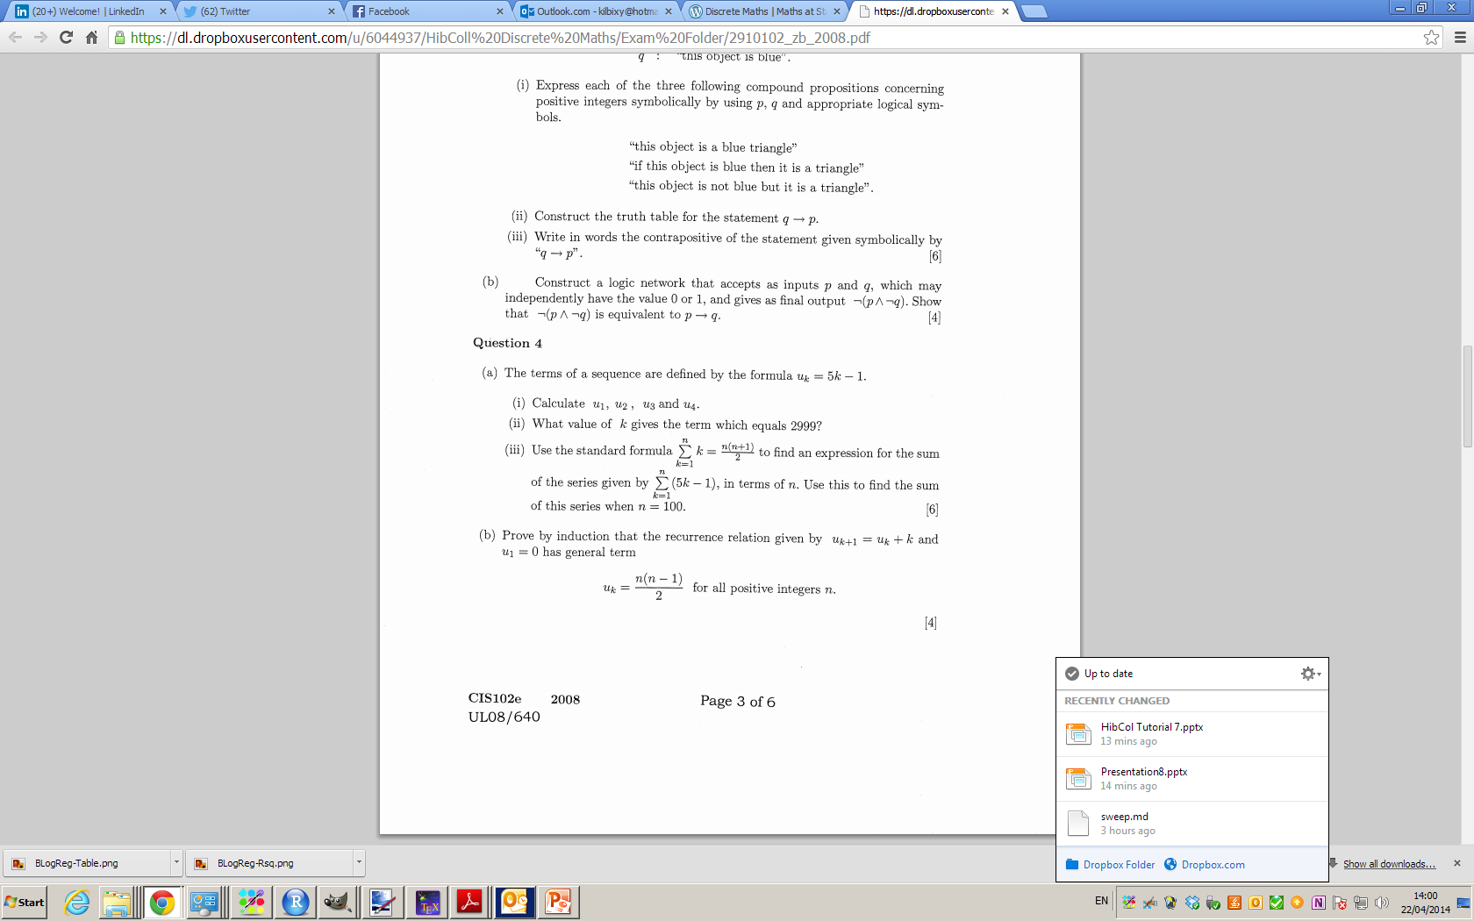
2008

Slide 43
2008

Slide 44
BLANK

Slide 45
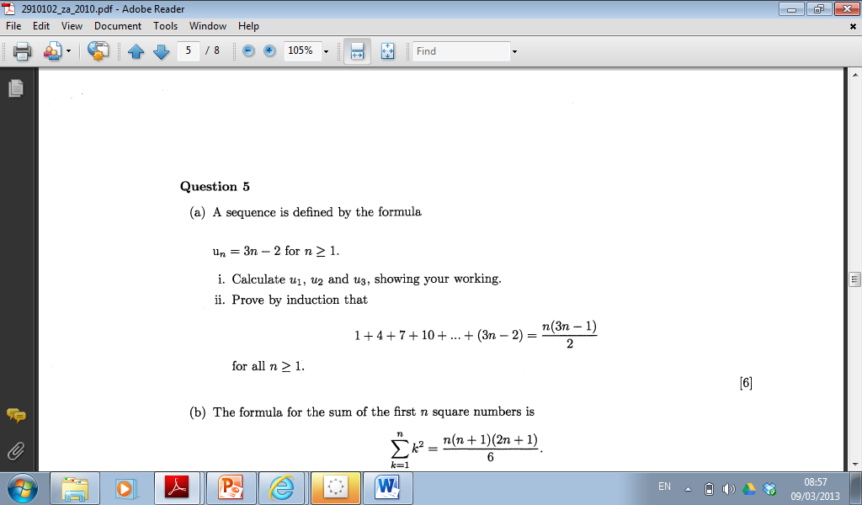
Past Paper Question (2010)

Slide 46
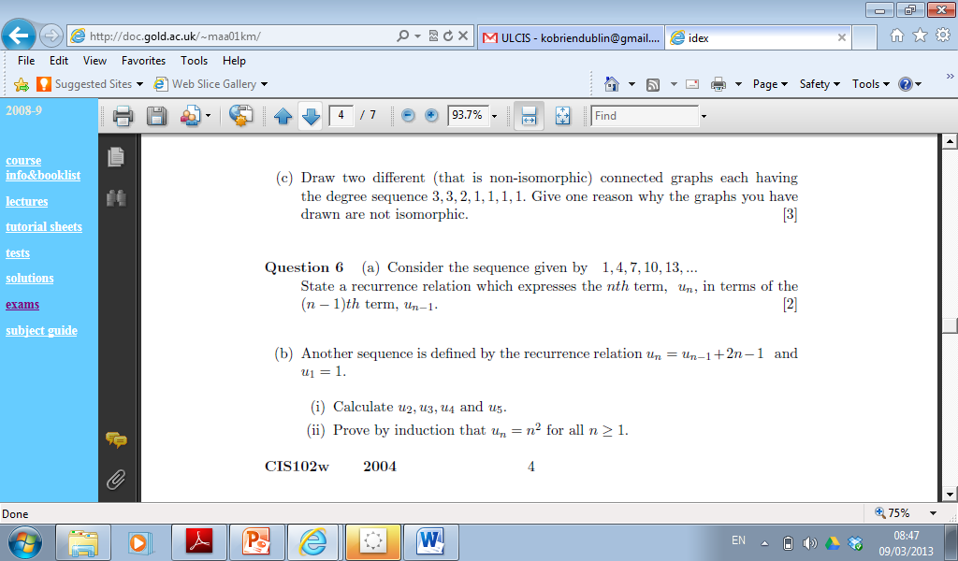
Past Paper Question (2004)

Slide 47
BLANK

Slide 48
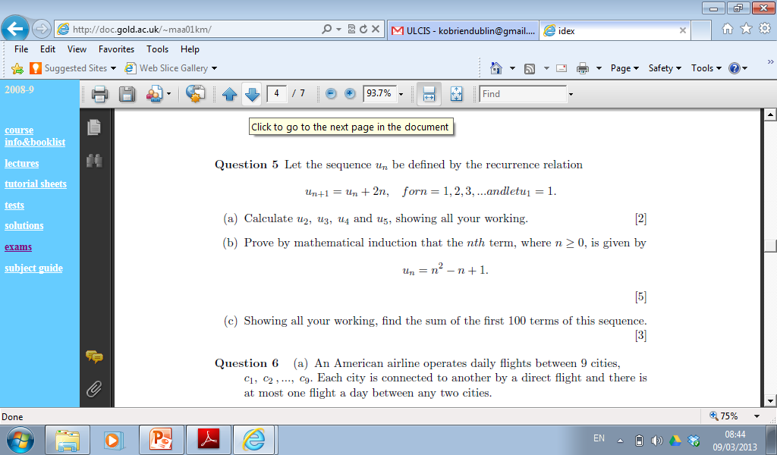
Past Paper Question (2005)

Slide 49
2005

Slide 50
2005

Slide 51
2006

Slide 52
2006

Slide 53
2006

Slide 54
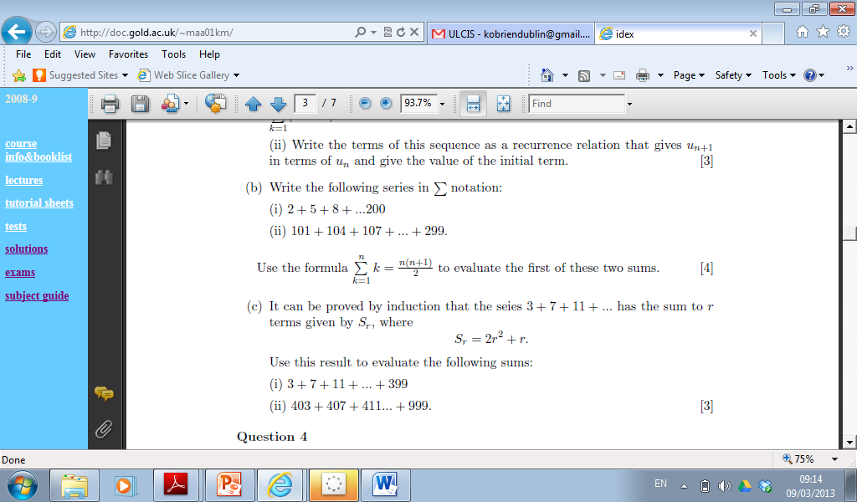
Past Paper Questions (2006)

Slide 55
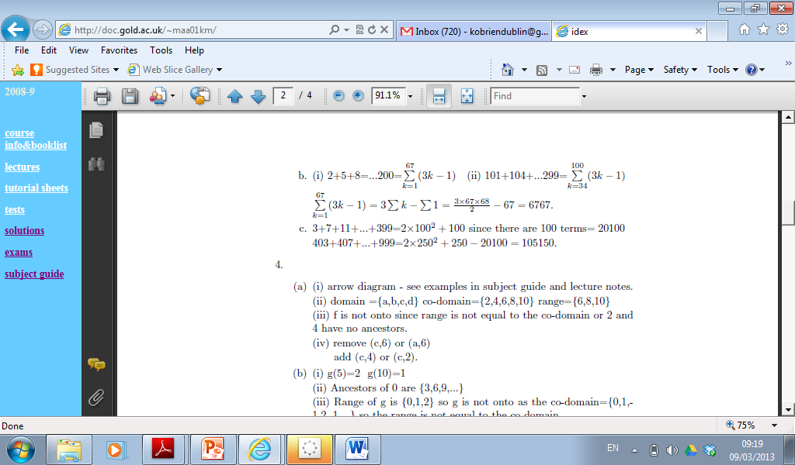
Sequence and Series
Solutions

Slide 56
Past Paper Question (2010)

